Slide 1
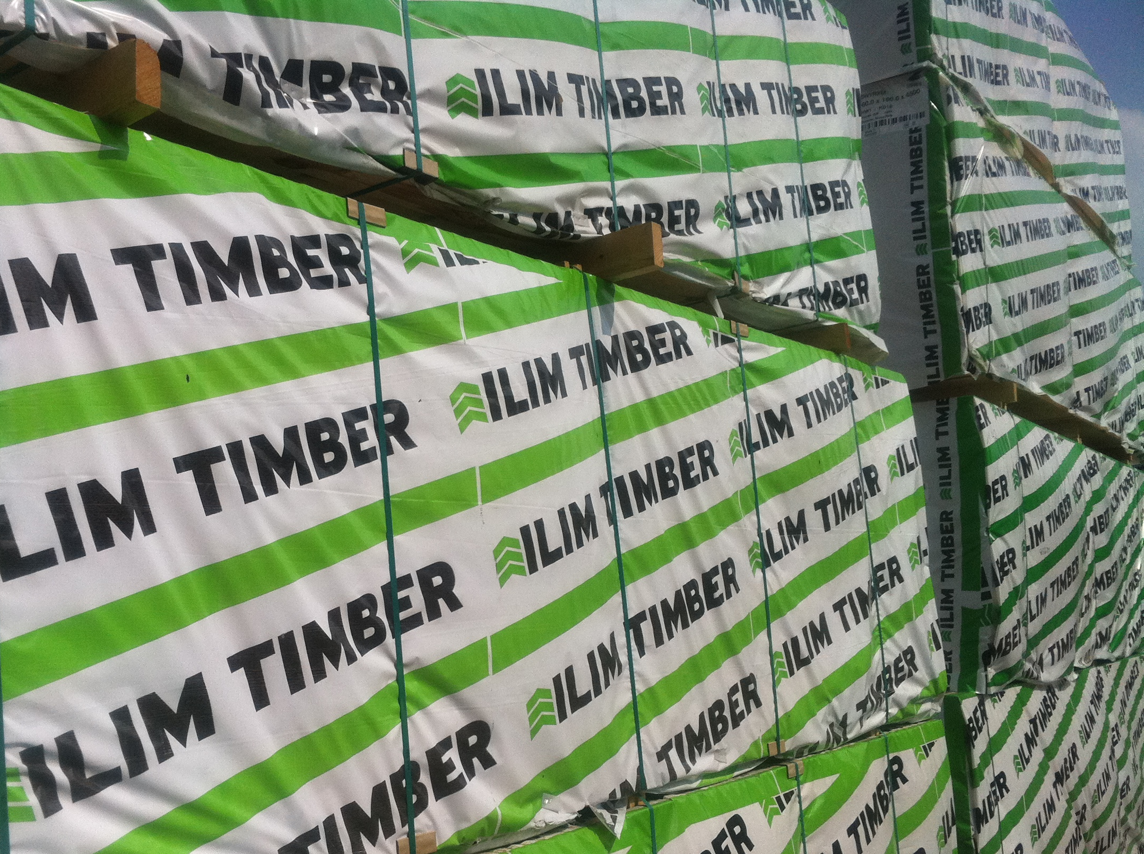
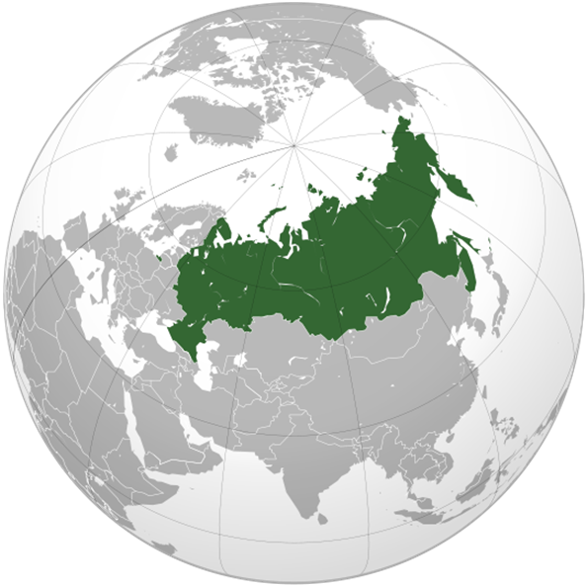

R U S S I A
THE ENIGMA
PAUL HERBERT
Member of the Board
GLOBAL SOFTWOOD LOG & LUMBER
CONFERENCE ,
VANCOUVER, MAY 07TH, 2015
RUSSIA LOG & LUMBER EXPORTS:
CURRENT & FUTURE OUTLOOK
Sviatoslav Bychkov, ILIM TIMBER
5th China Global Wood Trade Conference
September 15-16, 2015, Shanghai
RUSSIA – THE ENIGMA

Slide 2
TABLE OF CONTENTS
MACROECONOMICS
FOREST RESOURCES & SOFTWOOD SAW LOG
SOFTWOOD SAWN TIMBER
TRENDS & CONCLUSIONS

Slide 3

MACROECONOMICS

Slide 4
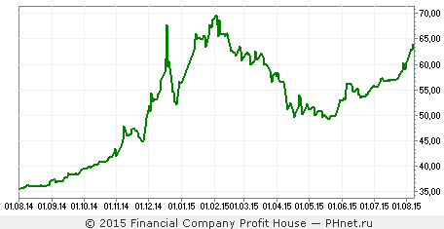
RUSSIA ECONOMY AND RUBLE VOLATILITY
USD/RUB rate 01.08.2014-01.08.2015
RUB
Volatility of the Ruble gives opportunities for exports and limits opportunities for investments

Slide 5
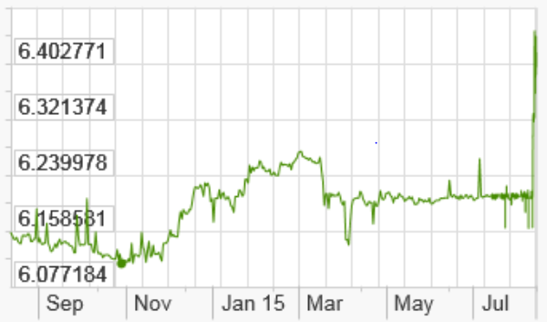
RUSSIAN EXPORT KEY MARKETS: CHINA
USD/CNY rate 08.2014-08.2015
CNY
Source: BMI, Bloomberg
Source: X-rates.com
CNY weakening fuels exports from China and will affect import volumes of commodities including timber

Slide 6
RUSSIAN EXPORT KEY MARKETS: MENA
MENA. Regional currencies change against USD, %
MENA region currencies devaluation leads to drop in import prices and domestic consumption

Slide 7
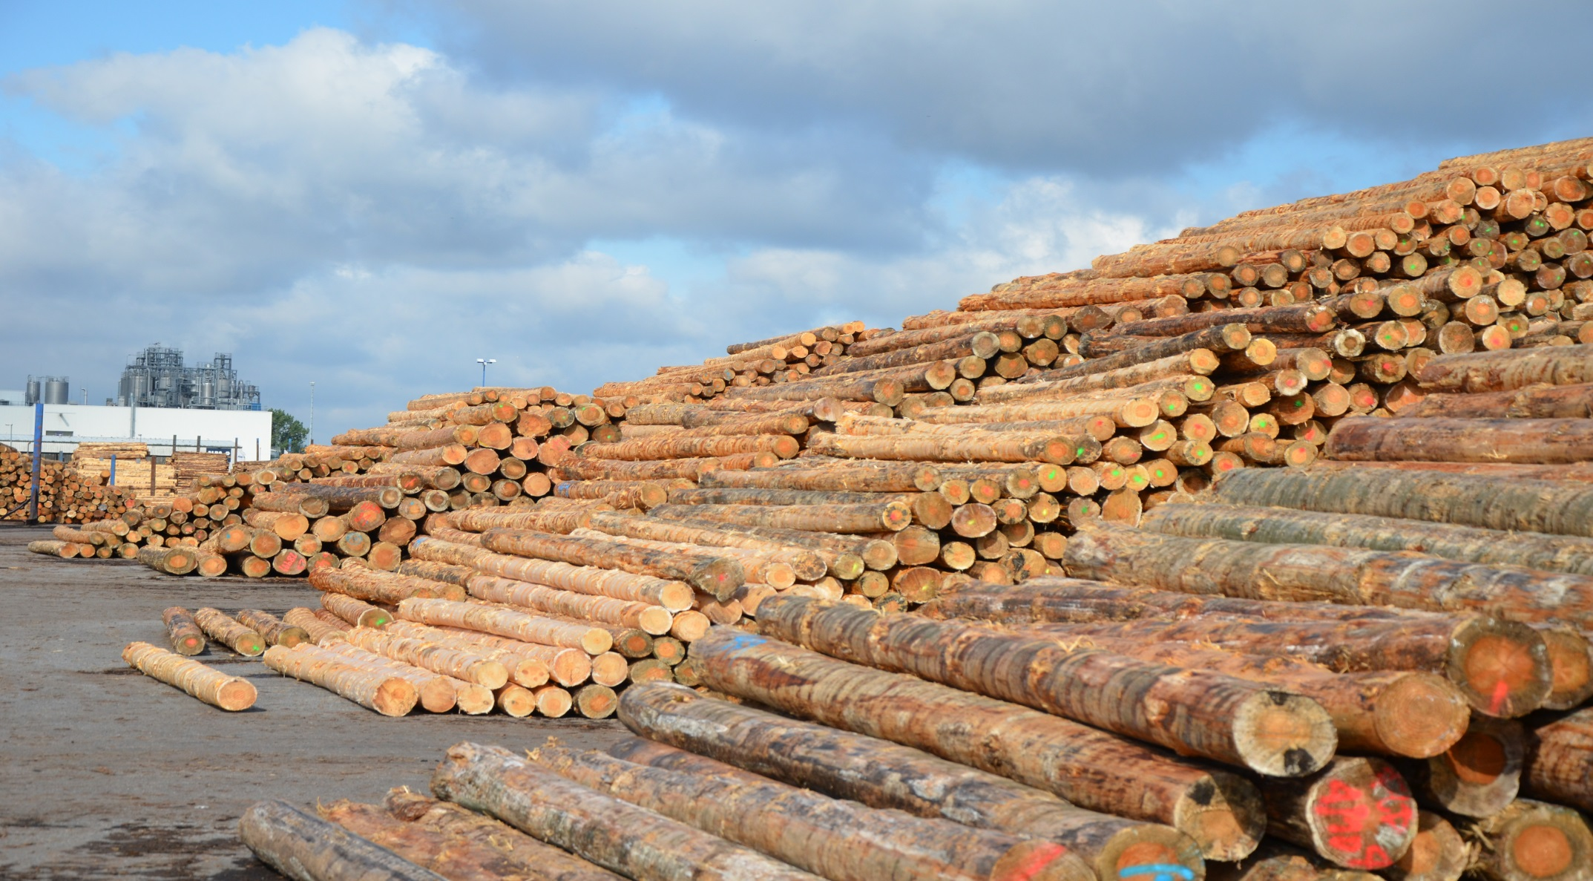
FOREST RESOURCES AND SOFTWOOD SAW LOG

Slide 8
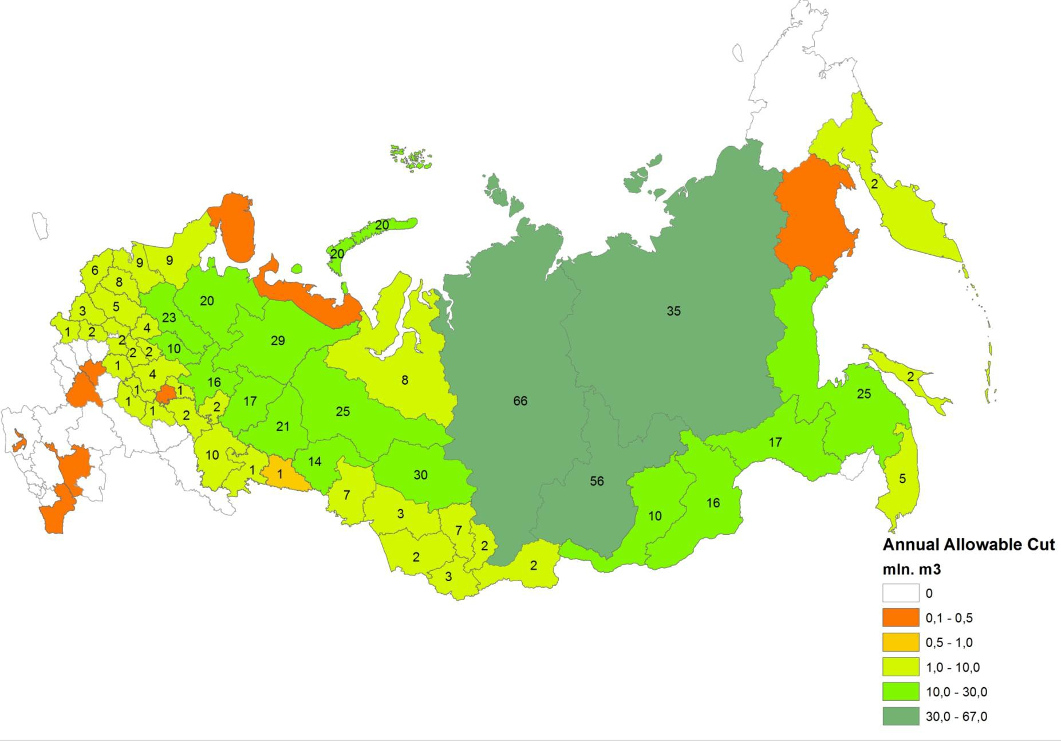
AAC IN RUSSIAN FORESTS
Growing stock: 82,1 billion m³:
coniferous 77%
deciduous 23%
Source: Natural Resources Institute Finland

Slide 9
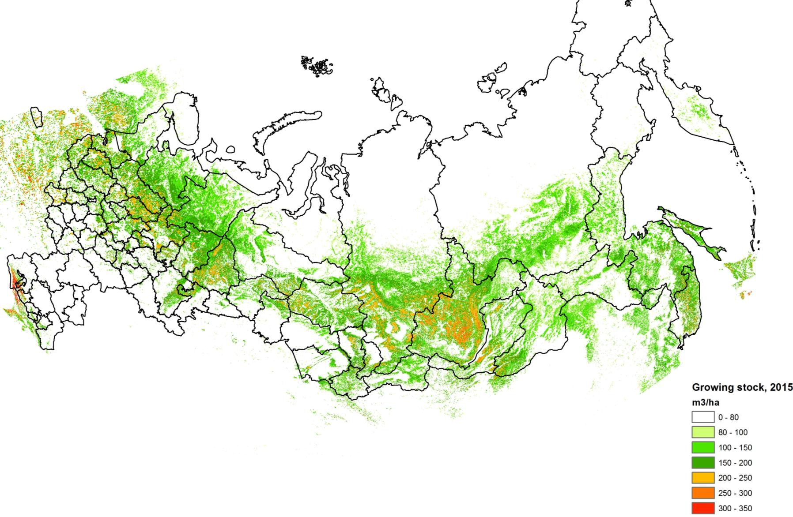
GROWING STOCK (stands more than 80 m³/ha)
717 mln. m³ annual available cut
2014 harvesting - 202,3 mln. m³ (+ 4,9%)
Source: www.forestrycloud.com

Slide 10
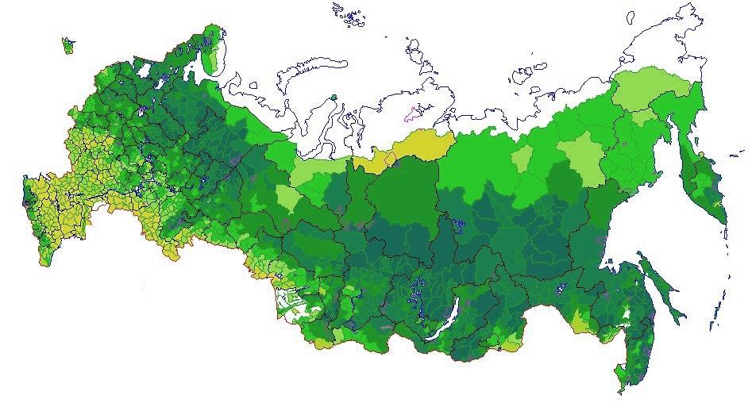
SOFTWOOD ROUND WOOD VOLUMES 2014
North-West
35%
Siberia & Far East
45%
139 million m³ softwood harvesting in 2014
Annual available cut in Siberia and Russian Far East less
than 15% utilized (vs 60% in NW Russia)

Slide 11
USSR AND RUSSIA: WOOD HARVESTING, CONSUMPTION, EXPORT
mln. m³

Slide 12
SOFTWOOD SAW LOG PRODUCTION
Production volume H1 2014 – 35.2 mln.m3
Production volume H1 2015 – 35.2 mln.m3
Source: Russian Customs

Slide 13
SOFTWOOD SAW LOG EXPORT KEY MARKETS
Total export volume in 2014 – 13.6 mln. m³ (+9.8% vs 2013 in volume and +8.3% in value)
The main market – China – 10.1 mln. m³ (+10.9% vs 2013 in volume and +9.5% in value, the second major supplier after New Zealand)
Europe - 1.4 mln. m³ (The main markets: Finland - 66%, Sweden - 19%, Germany -11%)
CIS – 0.35 mln. m³ (Uzbekistan - 89%)

Slide 14
SOFTWOOD LOG EXPORT H1 2014 VS H1 2015
Source: Russian Customs

Slide 15
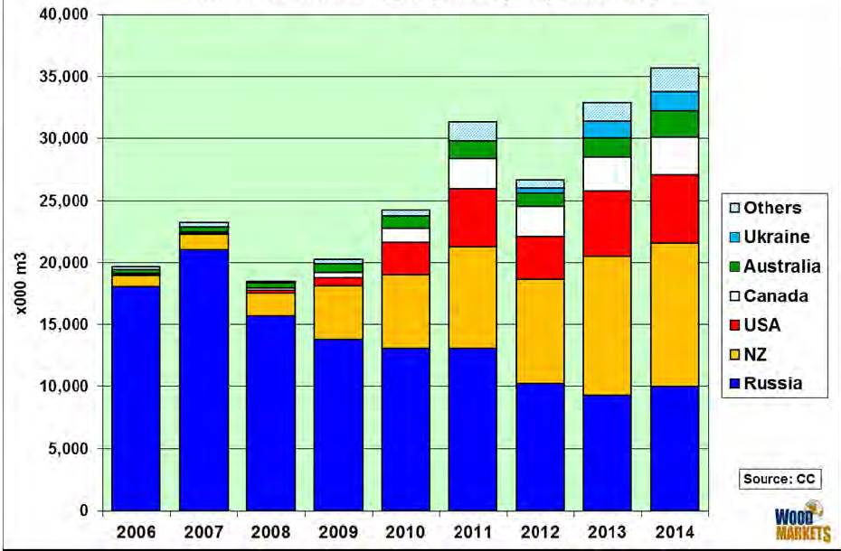
CHINA SOFTWOOD LOG IMPORT
Softwood saw log import from Russia stabilized on the level of 10 mln. m³ per year

Slide 16
SOFTWOOD LOG EXPORT VOLUME BY REGIONS 2014, m³
Source: Russian Customs
Sharp growth of softwood saw log export volumes to China in 4Q’14
corresponded to dramatic devaluation of Russian ruble

Slide 17
SOFTWOOD LOG EXPORT VOLUME BY SPECIES 2014, m³
Source: Russian Customs
Pine – 6.3 mln. m³ (46%)
Larch – 2.9 mln. m³ (21%)
3. Spruce – 4.2 mln. m³ (31%)
4. Other species – 0.19 mln. m³

Slide 18
SOFTWOOD SAW LOG EXPORT BY SPECIES H1 2014 VS H1 2015
Source: Russian Customs
Growth of larch log exports has been supported by China market
Notes:
Pine: H1 2014 –3.2 mln.m3 ; H1 2015 - 2.2 mln.m3
Larch: H1 2014 – 1.05 mln.m3; H1 2015 – 1.3 mln.m3
Spruce: H1 2014 – 1.5 mln.m3; H1 2015 - 1.2 mln.m3

Slide 19
SOFTWOOD LOG EXPORT VOLUME
Source: Russian Customs
-16%
Export H1 2014 – 5.8 mln.m³
Export H1 2015 – 4.8 mln.m³

Slide 20
CHINA SOFTWOOD LOG IMPORT H1 2014 VS H1 2015
-19,1%
Source: Russian Customs
Notes:
Russia –14%
NZ -7%
US -45%
Canada -14,1%

Slide 21
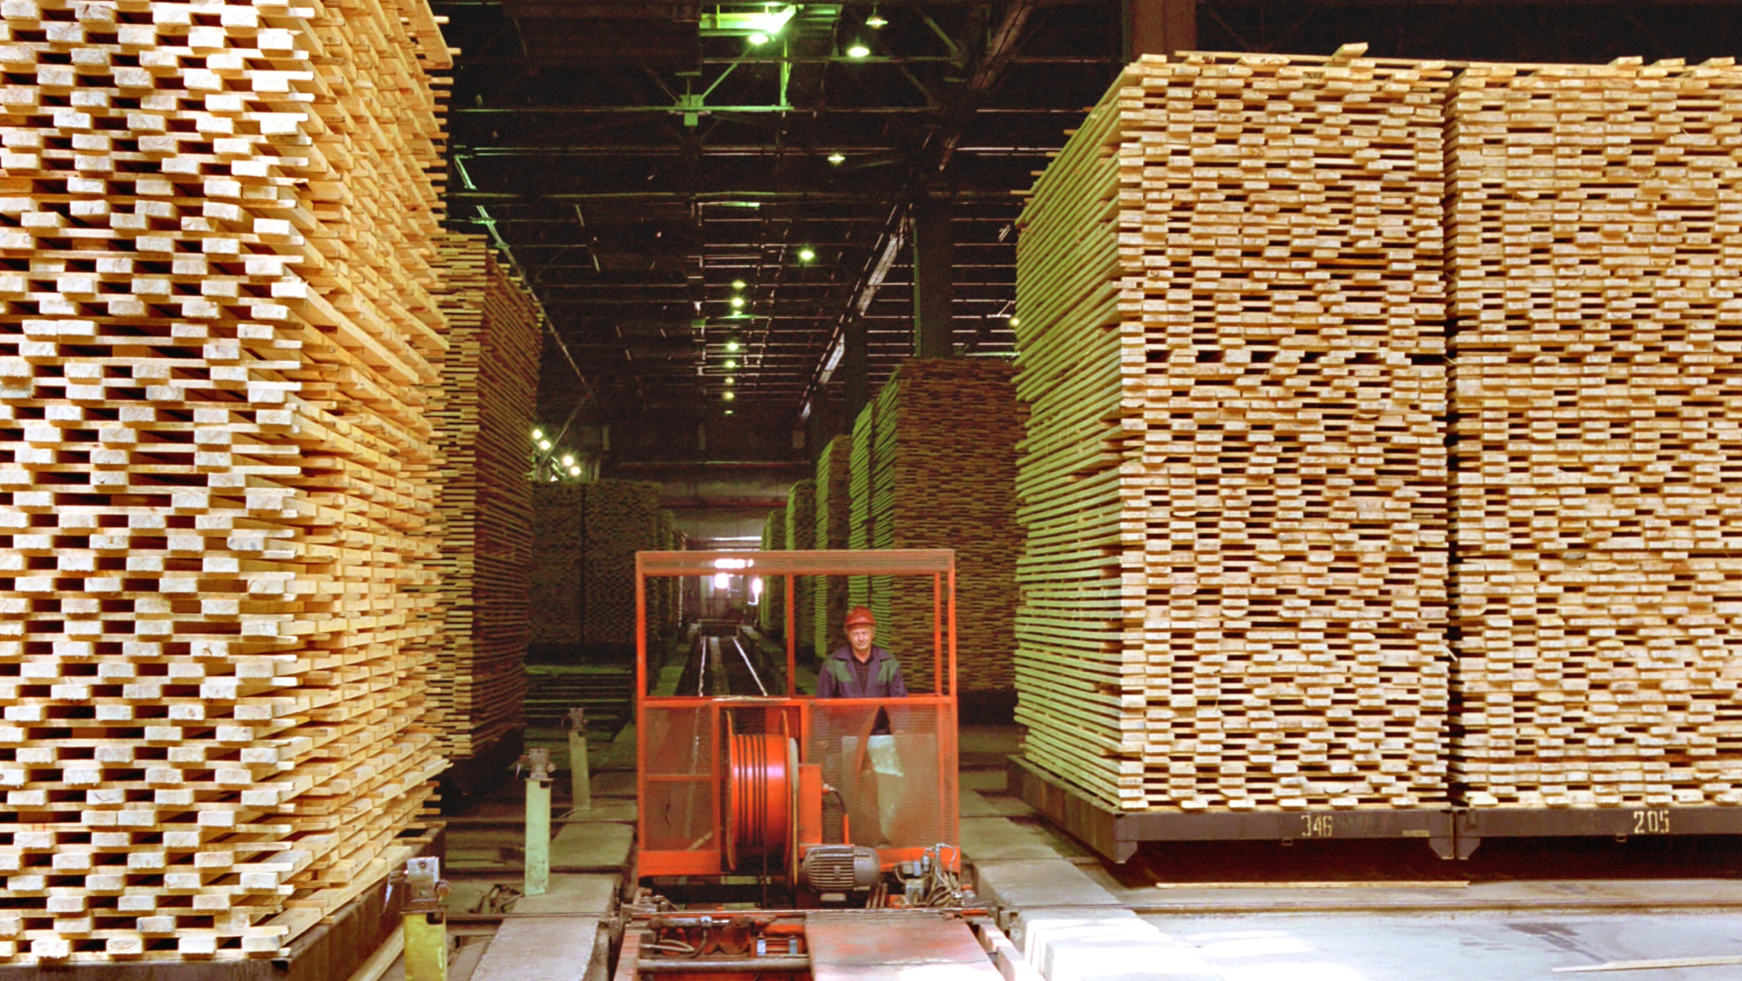
SAWN TIMBER

Slide 22
SOFTWOOD SAWN TIMBER EXPORT 2014
Total export volume in 2014 –
21.2 mln. m³ (4,5% growth to 2013)
China the main market –– 7.9 mln. m³ (+12.6% vs 2013 in volume and +14.5% in value, the leading supplier)
CIS – 5.55 mln. m³
MENA – 3.15 mln. m³
Europe - 3.1 mln. m³
Asia exl. China – 1.2 mln. m³
Source: Russian Customs

Slide 23
SOFTWOOD LUMBER EXPORT H1 2014 VS H1 2015, m³
Source: Russian Customs

Slide 24
SOFTWOOD SAWN TIMBER EXPORT 2014 H1 2014 VS H1 2015, m³
Source: Russian Customs

Slide 25
SOFTWOOD SAWN TIMBER EXPORT 2014, m³
Source: Russian Customs
Sharp growth of softwood sawn timber export volumes to all markets in 4Q’14 corresponded to dramatic devaluation of Russian ruble

Slide 26
SOFTWOOD SAWN TIMBER EXPORT BY REGIONS H1 2014 VS H1 2015, m³
+3 %
Source: Russian Customs

Slide 27
SOFTWOOD SAWN TIMBER EXPORT BY SPECIES H1 2014 VS H1 2015, m³
Source: Russian Customs
Species proportion in 2015 remains the same

Slide 28
CHINA SOFTWOOD LUMBER IMPORT H1 2014 VS H1 2015, m³
+3,4%
Source: Russian Customs
Notes:
Total export volume – 10.8 mln. m3 (+3% vs H1 2014):
Pine – 6.96 mln. m³ (+2% vs H1 2014 )
Spruce – 2.8 mln. m³ (+11% vs H1 2014 )
Larch – 1 mln. m³ (-4% vs H1 2014 )
Other species – 0.04 mln. m³

Slide 29
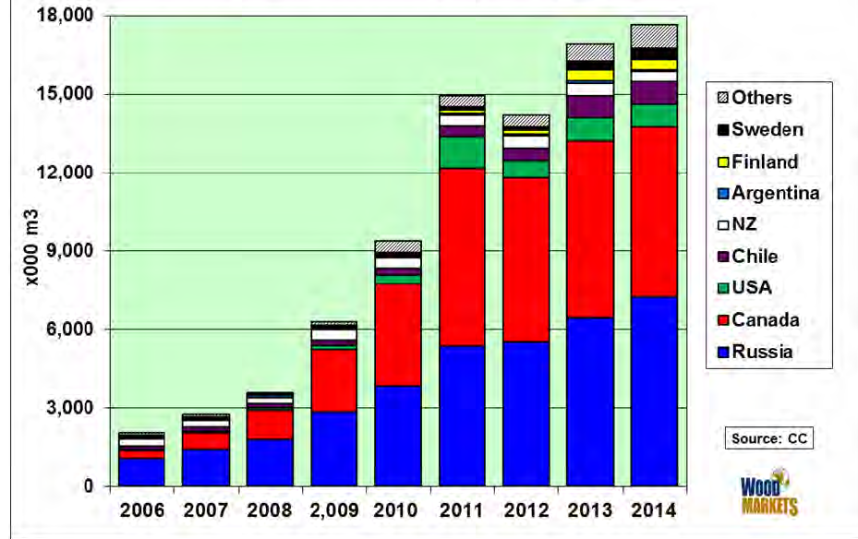
CHINA SOFTWOOD LUMBER IMPORT

Slide 30
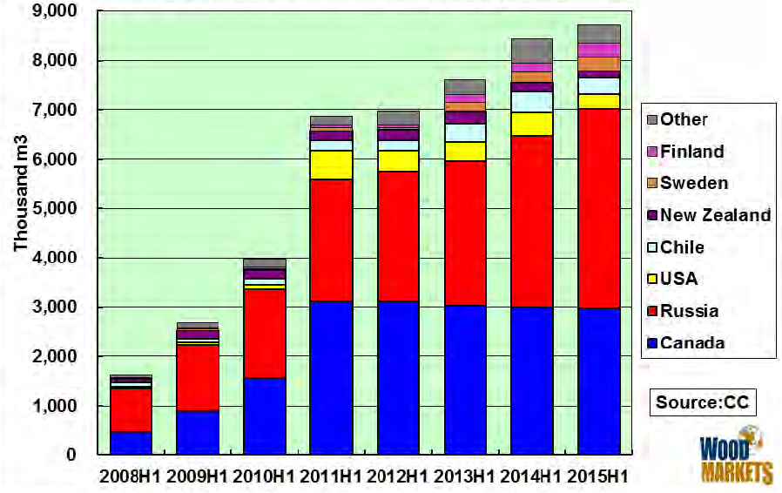
CHINA SOFTWOOD LUMBER IMPORT H1, m³

Slide 31
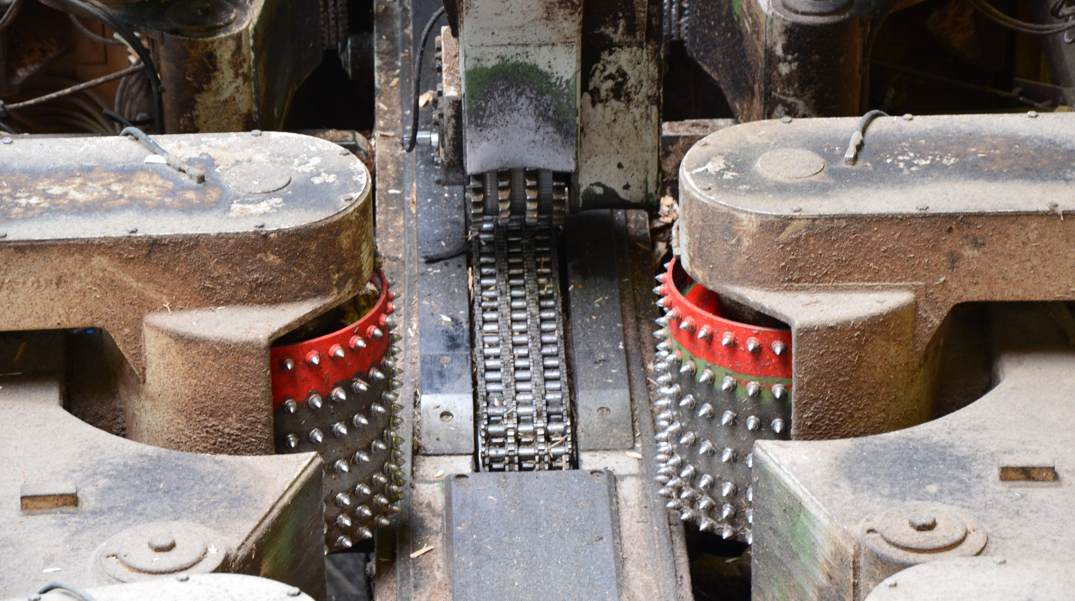
TRENDS & CONCLUSIONS

Slide 32
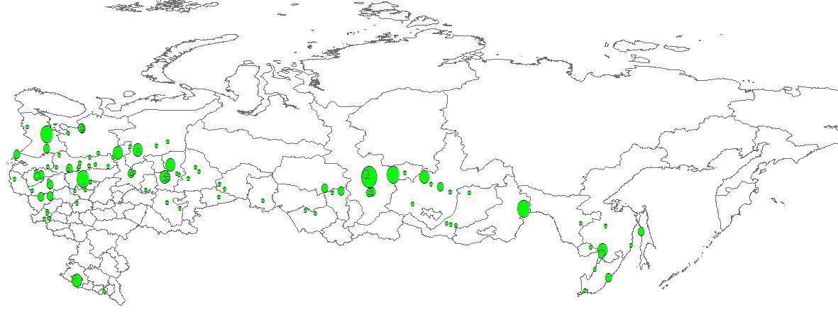
RUSSIA WILL INCREASE WOODWORKING CAPACITY PRIORITY INVESTMENT PROJECTS
Implementation 2006 – 2021, average payback time 6-7 years
121 state supported investment project (so far 36 are accomplished and 11 will come in 2015)
Reserved 70 mln.m³ from AAC (10% from whole Russian AAC)

Slide 33
CHINA REMAINS MAIN MARKET FOR RUSSIAN TIMBER
Russia is increasing capacity and modernizing wood working facilities in Siberia and Far East
Consumption in China outpaces growth of domestic softwood plantations S
Russia is China’s lowest cost source of softwood with daily deliveries with differences on regional logistics
Quality of Russian fiber is very high securing strong demand from OEM market segment

Slide 34
GOVERNMENT INTERVENTIONS
From 49 to 98 years rent in preferable order for reliable forest users (new federal law to be introduced in 2015)
Federal electronic system for control of timber redistribution (ЕГАИС) is in place and will start running July 01, 2015 (415 Federal Law)
In 2015 payments for the use of forest resources grow up 5,3% and railway tariffs 10% . Moderate growth considering ruble devaluation

Slide 35
CONCLUSIONS
China remains the key market for Russian log and lumber with increasing lumber export
Modernization of sawn timber industry and redistribution of volumes from domestic market leads to growth of lumber export from Russia
CNY currency volatility will not affect timber imports from Russia as much as imports from USA and Canada
Government initiative is strongly required to inspire investments from China into Russian woodworking industry

Slide 36
R U S S I A
THE ENIGMA
PAUL HERBERT
Member of the Board
GLOBAL SOFTWOOD LOG & LUMBER
CONFERENCE ,
VANCOUVER, MAY 07TH, 2015
THANK YOU
FOR YOUR ATTENTION!
谢谢你们的注意
RUSSIA – THE ENIGMA

